Slide 1
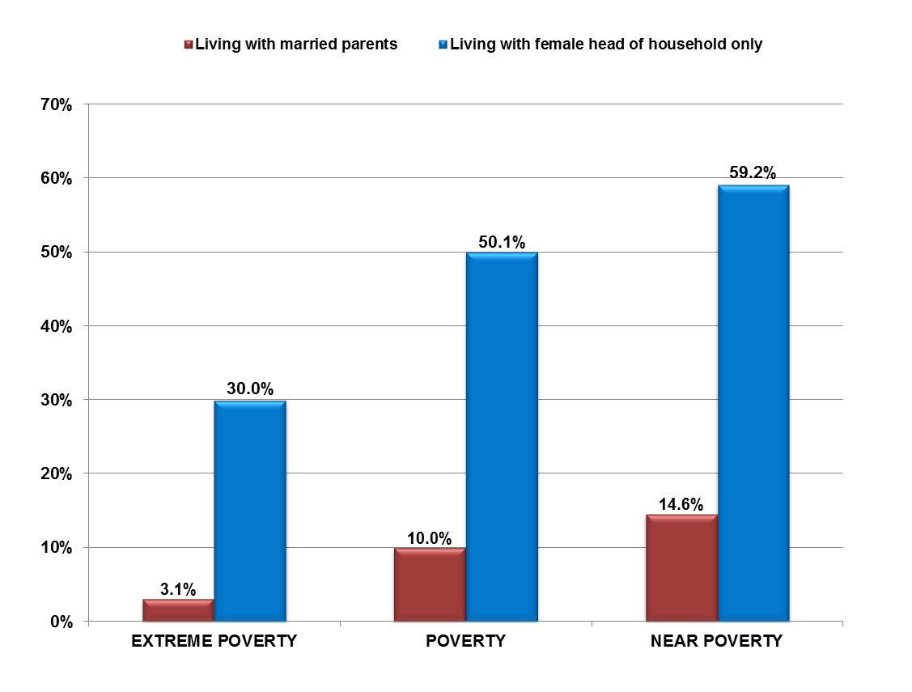
Extreme Poverty, Poverty, and Near Poverty Rates for Children Under Age 5, by Living Arrangement: 2015
The data for Extreme Poverty, Poverty, and Near Poverty Rates for Children Under Age 5, by Living Arrangement are from table POV02 (50% of poverty, 100% of poverty, and 125% of poverty) People in Families by Family Structure, Iterated by Income-to-Poverty-Ratio, U.S. Census Bureau, Current Population Survey, 2012 Annual Social and Economic Supplement.
Extreme poverty: Below 50% of poverty
Poverty: Below 100% of poverty
Near poverty: Below 125% of poverty
Source: U.S. Census Bureau, Current Population Survey, 2016 Annual Social and Economic Supplement.

Slide 2
2016 Poverty Guidelines for the
48 Contiguous States and Washington, D.C.
Persons in family/household | Poverty guideline
1 | $11,880
2 | $16,020
3 | $20,160
4 | $24,300
Source: U.S. Department of Health and Human Services. (2016, January). Federal Register, 81(15), 4036–4037.

Slide 3
Household Income in 20% Increments of Total: 2015
Group | Average Household Income Ranges: 2015
LOWEST 20% | $0–$22,800
SECOND 20% | $22,801–$43,507
THIRD 20% | $43,508–$72,000
FOURTH 20% | $72,001–$117,002
HIGHEST 20% | $117,003+
TOP 5% (part of highest 20%) | $214,462+
Source: U.S. Census Bureau, Current Population Survey, 2016 Annual Social and Economic Supplement (households as of March of the following year).

Slide 4
Breakdown of U.S. Households, by Total Money Income: 2015
Income | # of U.S. Households (in millions) | % of All U.S. Households
Less than $10,000 | 8,306 | 6.6%
$10,000 to $14,999 | 6,324 | 5.0%
$15,000 to $24,999 | 13,235 | 10.5%
$25,000 to $34,999 | 12,576 | 10.0%
$35,000 to $49,999 | 15,948 | 12.7%
$50,000 to $74,999 | 21,001 | 16.7%
$75,000 to $99,999 | 15,199 | 12.1%
$100,000 to $149,999 | 17,777 | 14.1%
$150,000 to $199,999 | 7,811 | 6.2%
$200,000 or more | 7,640 | 6.1%
Total Households | 125,819,000 | 100%
Estimated median household income: $56,516
Source: U.S. Census Bureau, Current Population Survey, 2016 Annual Social and Economic Supplement.

Slide 5
Number and Percentage of Children in Poverty, by Race: 2015
 | NUMBER OF CHILDREN IN POVERTY | PERCENTAGE OF CHILDREN IN POVERTY
ALL RACES | 14,509,000 | 19.7%
WHITE | 4,563,000 | 12.1%
AFRICAN AMERICAN | 4,146,000 | 32.9%
HISPANIC* | 5,269,000 | 28.9%
ASIAN AMERICAN | 466,000 | 12.3%
AMERICAN INDIAN AND ALASKA NATIVE** | 233,277 | 33.8%
NATIVE HAWAIIAN AND OTHER PACIFIC ISLANDER** | 36,733 | 25.9%
*Hispanics may be of any race.
**Data from U.S. Census Bureau. (2016, September). 2015 American Community Survey 1-Year Estimates.
Source: U.S. Census Bureau, Current Population Survey, 2016 Annual Social and Economic Supplement.

Slide 6
U.S. Median Income for Persons
Age 25 and Older,
by Sex and Educational Attainment: 2015
 | Overall (with earnings) | Less Than Ninth Grade | Grades 9–12 (no diploma) | HS Diploma (includes GED) | Associate's Degree | Bachelor's Degree | Master's Degree | Professional Degree | Doctorate
 |  |  | Numbers of persons with earnings (in thousands)
Male | 75,263 | 2,783 | 4,194 | 20,951 | 7,325 | 17,325 | 7,116 | 1,530 | 1,813
Female | 66,370 | 1,498 | 2,540 | 15,186 | 8,397 | 16,710 | 8,147 | 1,033 | 1,358
 |  |  | Median earnings, in 2015 dollars
Male | $47,100 | $25,411 | $28,102 | $37,003 | $47,104 | $65,190 | $78,463 | $120,247 | $100,569
Female | $32,499 | $16,953 | $17,054 | $25,385 | $32,038 | $44,092 | $54,801 | $75,979 | $71,040
Source: U.S. Census Bureau, Current Population Survey, 2016 Annual Social and Economic Supplement.

Slide 7
U.S. Per-Capita Income, Median Household Income,
and Median Family Income: 1967 to 2015
Year | Per-Capita Income | Median Household Income | Median Family Income
2015 | 32,653 | 53,657 | 76,697
2014 | 30,176 | 53,657 | 66,632
2013 | 28,184 | 52250 | 64,030
2012 | 27,319 | 51,371 | 62,527
2011 | 26,708 | 50,502 | 69,821
2010 | 26,059 | 50,046 | 60,609
2009 | 26,409 | 50,221 | 61,082
2008 | 27,589 | 52,029 | 63,366
2005 | 25,035 | 46,242 | 55,832
2000 | 22,970 | 43,162 | 52,148
1995 | 19,871 | 39,306 | 46,843
1990 | 18,894 | 39,324 | 46,429
1985 | 17,280 | 37,059 | 43,518
1980 | 15,844 | 36,035 | 42,776
1975 | 13,972 | 34,980 | 39,784
1970 | 12,543 | 35,232 | 38,954
1967 | 11,067 | 32,783 | 35,629
Source: U.S. Census Bureau, Current Population Survey, 2016 Annual Social and Economic Supplement.

Slide 8
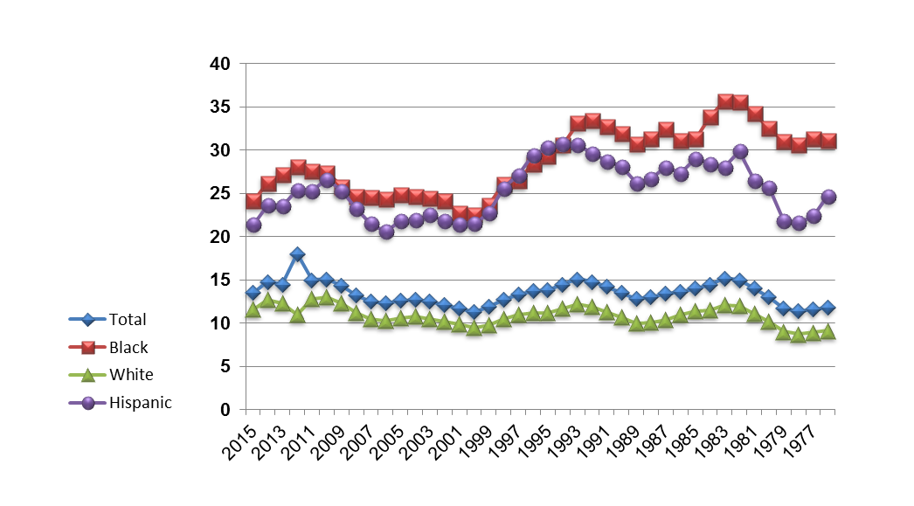
Percentage of
U.S. Persons Below Poverty Level, by Race
and Ethnicity:
1976 to 2015
Year | Total | Black | White | Hispanic
2015 | 13.5 | 24.1 | 11.6 | 21.4
2014 | 14.8 | 26.2 | 12.7 | 23.6
2013 | 14.5 | 27.2 | 12.3 | 23.5
2012 | 18.0 | 28.1 | 11.0 | 25.4
2011 | 15.0 | 27.6 | 12.8 | 25.3
2010 | 15.1 | 27.4 | 13.0 | 26.6
2009 | 14.3 | 25.8 | 12.3 | 25.3
2008 | 13.2 | 24.7 | 11.2 | 23.2
2007 | 12.5 | 24.5 | 10.5 | 21.5
2006 | 12.3 | 24.3 | 10.3 | 20.6
2005 | 12.6 | 24.9 | 10.6 | 21.8
2004 | 12.7 | 24.7 | 10.8 | 21.9
2003 | 12.5 | 24.4 | 10.5 | 22.5
2002 | 12.1 | 24.1 | 10.2 | 21.8
2001 | 11.7 | 22.7 | 9.9 | 21.4
2000 | 11.3 | 22.5 | 9.5 | 21.5
1999 | 11.9 | 23.6 | 9.8 | 22.7
1998 | 12.7 | 26.1 | 10.5 | 25.6
1997 | 13.3 | 26.5 | 11.0 | 27.1
1996 | 13.7 | 28.4 | 11.2 | 29.4
Year | Total | Black | White | Hispanic
1995 | 13.8 | 29.3 | 11.2 | 30.3
1994 | 14.5 | 30.6 | 11.7 | 30.7
1993 | 15.1 | 33.1 | 12.2 | 30.6
1992 | 14.8 | 33.4 | 11.9 | 29.6
1991 | 14.2 | 32.7 | 11.3 | 28.7
1990 | 13.5 | 31.9 | 10.7 | 28.1
1989 | 12.8 | 30.7 | 10.0 | 26.2
1988 | 13.0 | 31.3 | 10.1 | 26.7
1987 | 13.4 | 32.4 | 10.4 | 28.0
1986 | 13.6 | 31.1 | 11.0 | 27.3
1985 | 14.0 | 31.3 | 11.4 | 29.0
1984 | 14.4 | 33.8 | 11.5 | 28.4
1983 | 15.2 | 35.7 | 12.1 | 28.0
1982 | 15.0 | 35.6 | 12.0 | 29.9
1981 | 14.0 | 34.2 | 11.1 | 26.5
1980 | 13.0 | 32.5 | 10.2 | 25.7
1979 | 11.7 | 31.0 | 9.0 | 21.8
1978 | 11.4 | 30.6 | 8.7 | 21.6
1977 | 11.6 | 31.3 | 8.9 | 22.4
1976 | 11.8 | 31.1 | 9.1 | 24.7
Source: U.S. Census Bureau, Current Population Survey, 2016 Annual Social and Economic Supplement.

